Slide 1
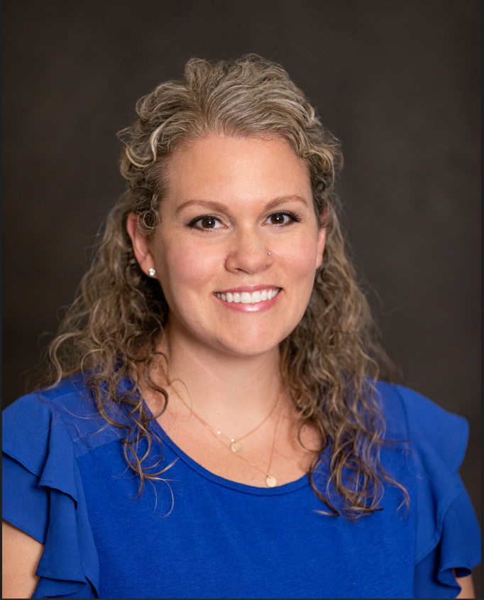


Skin Team Introduction Course
Speaker:
Laura Welch, MSN, RN, CWON, NPD-BC, CPN
October 14, 2026
1:00 – 3:00 pm
Join on Teams
Target Audience: Registered Nurses who are new to the Children’s National Skin Team
To claim credit, text SMS code provided during your session to 301-273-7643
Or enter the code at ce.childrenational.org/code
Learning Objectives:
Participants will link skin pathophysiology concepts to their role in pressure injury development
Participants will apply evidence-based strategies for the treatment of pressure injuries and wounds.
Participants will interpret pressure injury data using the NDNQI data collection framework.
Participants will become familiar with resources at CNH that support Pressure Injury prevention.
Joint Accreditation: In support of improving patient care, this activity has been planned and implemented by Children’s National Hospital. Children’s National Hospital is jointly accredited by the Accreditation Council for Continuing Medical Education (ACCME), the Accreditation Council for Pharmacy Education (ACPE), and the American Nurses Credentialing Center (ANCC), to provide continuing education for the healthcare team. Children’s National Hospital Accreditation Provider# 4008362
ANCC Credit Designation Statement: Children’s National Hospital designates this activity for a maximum of 2.0 Live ANCC contact hours.

