Slide 1
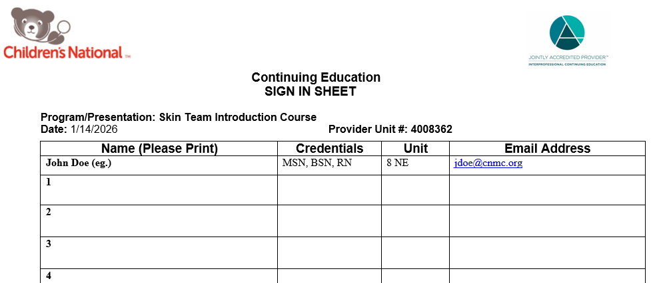
Skin Team Intro Course
July 8, 2026
Turn video on
To obtain CNEs for today you need to:
Be present for the AM & PM sessions
Type your name in the chat box AM & PM
  Write “data” after your name if you are collecting data
Program/Presentation: Skin Team Introduction Course Provider Unit #: 4008362
Date: July 8, 2026
Laura Welch, MSN, RN, CWON, NPD-BC, CPN
Sr. Nursing Quality Outcomes & Safety Coordinator

Slide 2
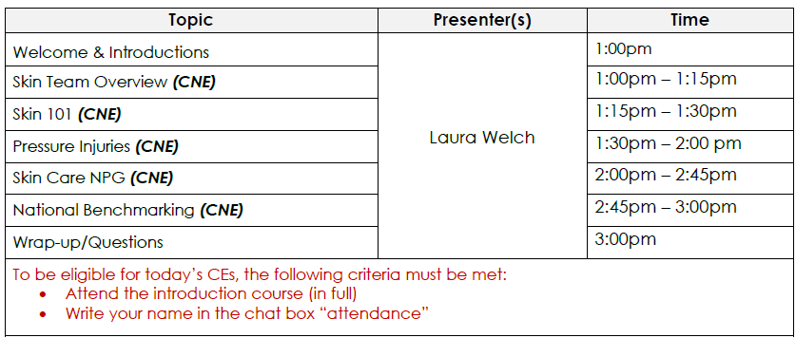
Today’s Agenda

Slide 3

Continuing Education – Learner Notification
Skin Team Introduction Course
July 8, 2026
Notice of Requirement for successful completion
Participants may obtain CE Contact Hours for this education if you attend the entire education session(s), select sessions attended, and complete an evaluation. A code and link/text number will be provided at the end.
Nurses: Children’s National Hospital designates this live activity for a maximum of 2.0 ANCC contact hour(s) for nurses. Nurses should claim only the credit commensurate with the extent of their participation in the activity.
Relevant Financial Relationships
The planning committee and presenters have no relevant financial relationships with ineligible companies.
Financial and In-Kind Commercial Support
No financial nor in-kind commercial support was received for this education activity.
In support of improving patient care, this activity has been planned and implemented by Children’s National Hospital. Children’s National Hospital is jointly accredited by the Accreditation Council for Continuing Medical Education (ACCME), the Accreditation Council for Pharmacy Education (ACPE), and the American Nurses Credentialing Center (ANCC), to provide continuing education for the healthcare team. Children’s National Hospital Accreditation Provider# 4008362.

Slide 4
Skin Team Overview

Slide 5
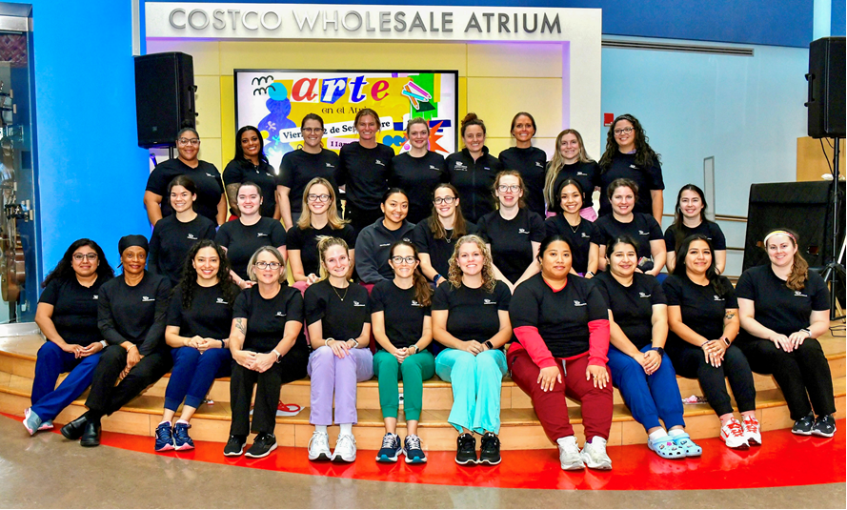
Skin Team Members
60+ RNs & PCTs
  All 10 inpatient units
  All non-inpatient departments
  Ambulatory clinics
Notes:
Need an updated picture
ENT clinic
PACU
Cardiac Cath
Now CPRU

Slide 6
Skin Team Meetings
Morning
7am – 8:45am
Updates
“Transfer of knowledge” unit projects
Inter-Rater Reliability
Data Collection
8:45am – 12:30pm
Afternoon
1:15pm – 3:30pm
Didactic
Hands-on*
Guest lectures
Projects
2nd Wednesday of every month
HALF days
  1st month each quarter
  0700-1230
    AM session only
FULL days
  2nd & 3rd months each quarter
  0700-1530
    AM & PM sessions

Slide 7
Attendance
Attendance is YOUR responsibility
Virtual Sign in Process
  Write your name in the chat box
  Morning & afternoon
If you are unable to attend the meeting, notify:
  Laura Welch (SkinTeam@cnmc.org)
  AND your fellow unit-based Skin Team members

Slide 8
Attendance
75% = 3 absences a year (sick/vacation/etc.)
  Excused absences: FMLA, religious, work/educational conferences, military commitments, orientation, staffing pulls (must let me know within 24 hours)
    Staffing pulls= NOT SCHEDULED TO WORK
      Scheduled to be out of staffing or in “education” for Skin Team days and pulled in by the Ads/unit to support the unit numbers that morning
    Would not include attendance for doing assessments while in staffing (missed inter-rater- NDNQI requirement)
    Working the P shift before the meeting will count for attendance if you attend the full AM session
      May not get you CNEs though if you are unable to attend the pm session on days it is offered
Notes:
*Must notify Laura within 24 hours for credit*
Cannot be notified months after the fact at the time of the CAP submission

Slide 9
CAP Attendance Requirements
Minimum of 6 months on the Skin Team
>75% (NDNQI/Inter-rater)
  Attendance will be pulled from the monthly chat
    Attending Inter-rater is a necessity by NDNQI for attendance. Collecting data for the month without attending the morning zoom session will not count for attendance for the month
    Attendance will not be pulled from your timecard on that day
  Then sign-in sheet if in person (afternoon sessions)
Attendance <75%: you remain on the Skin Team ☺
  Ineligible for CAP, independent data collection/patient assessments (still able to do with a ST member)
Notes:
Staffing pulls: NOT SCHEDULED TO WORK
Scheduled to be ‘out of staffing’ for skin team days and pulled in by the ADs to support the unit numbers that morning

Slide 10
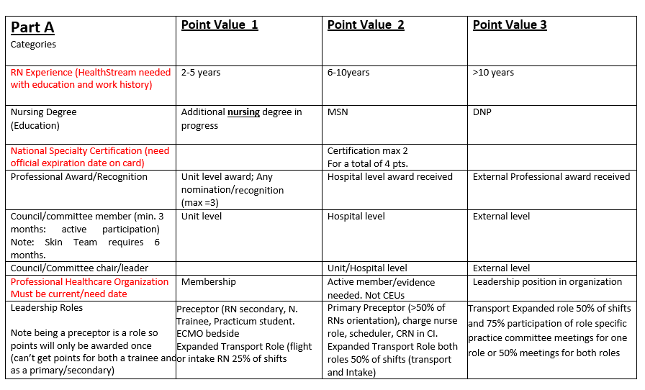
CAP Points
Notes:
Part A – 2pts hospital level committee
possible 2 pts additional for co-chairs

Slide 11
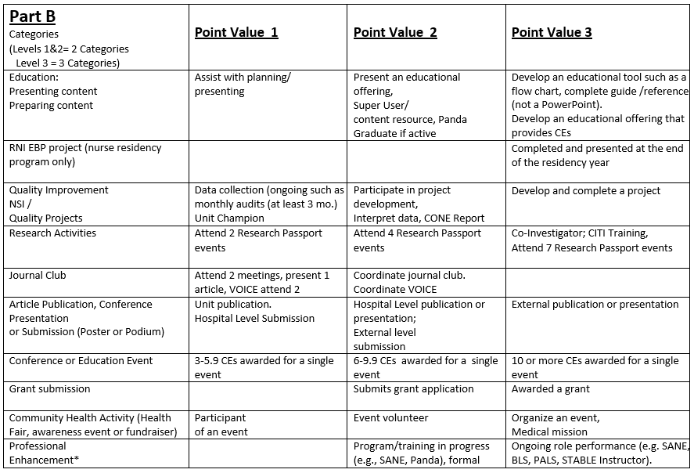
CAP Points
Notes:
Part B –
Education: may have 1-3 points
Quality Improvement : 1 point Data Collection with head-to-toe assessments
Quality Improvement: 1-3 points for monthly audits and participation in QI project
Article publication/conference: 1-3 points
Conference or Education Event: 1-3 points

Slide 12
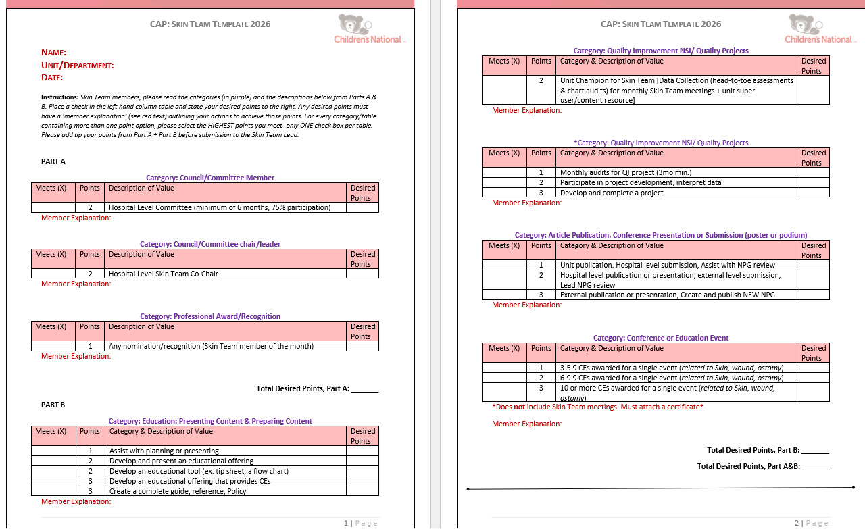
CAP Skin Team Submission Form

Slide 13
CNEs
Provided for every meeting
Requirements:
  Be present for entire session(s) in full (AM/PM)
  Sign-in into Zoom chat
    Both AM & PM sessions
Notes:
24 CNE License renewal (every 2 years)

Slide 14
Transfer of Knowledge
Objective
  Development of education skills for transfer/comfort of knowledge with peers
Yearly project
  Individual or group focus
Peer feedback or report outs
Projects
  Monthly focus
  “Homework”
  Templates provided
Conflict of Interest forms (CNE requirement)

Slide 15
Skin Team 2026 Annual Project

Slide 16
Strengthening Pressure Injury Prevention:
One Bundle Element at a Time
Skin Team Annual Project
January – December 2026

Slide 17
Driving PI Bundle Improvement at the Unit Level
System-Level Goal: Reduce hospital-acquired pressure injuries and improve adherence to the SPS* Pressure Injury Prevention Bundle elements
Unit-Level Focus: Each unit selects one SPS bundle element that represents a meaningful opportunity for improvement based on unit data, culture, or compliance
  Ask: Develop and implement a meaningful unit-level QI project to support that element
Project Ownership: Unit Skin Team in partnership with unit leadership
*SPS = Solutions for Patient Safety

Slide 18
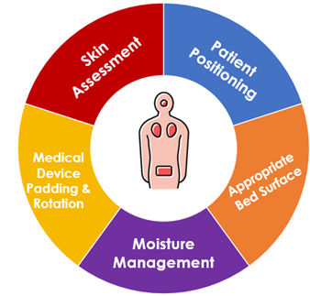
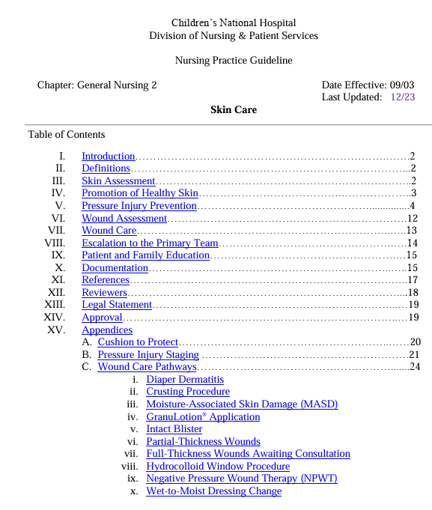
Pressure Injury (PI)
Prevention Bundle Elements
Need more Info?
Check the Skin Care Nursing Practice Guideline
PI Bundle: pp. 6–12
Skin Care NPG

Slide 19
SPS PI Bundle: Standard Elements
Skin Assessment:
Full skin and pressure injury risk assessment on admission and at least every 24 hours; reassess with condition changes
Medical Device Rotation/Repositioning:
Assess skin under devices each shift; rotate or reposition devices per manufacturer guidance; inspect under removable devices at least twice daily
Patient Positioning:
Reposition patients at least every 2 hours or timed with care; limit time upright without pressure redistribution
Appropriate Surface:
Use support surfaces based on patient risk; reassess need for specialty surfaces using PI risk assessment
Moisture Management:
Keep skin clean, dry, and hydrated; apply moisture barriers or wicking products as indicated

Slide 20
SPS PI Bundle: Recommended Elements
Non-Device Padding:
Consider prophylactic padding over bony prominences; assess skin under padding at least daily
Assessment for Proper Fit of Respiratory Devices:
Routine assessment of masks, nasal cannula, tracheostomy ties, and ETTs to ensure devices are not too tight
Device Padding:
Use prophylactic padding under medical devices per manufacturer instructions when available and not contraindicated

Slide 21
Project Aim and Measures
Aim: By December 2026, improve compliance with the selected SPS bundle element to ≥90% and contribute to a reduction in overall unit pressure injuries
System Level Outcome Measures: Overall HAPI rate; Aggregate Bundle Compliance Scores
Unit Level Outcome Measures: Unit-chosen outcomes related to the selected bundle element
(for example: repositioning reliability, device checks, skin assessment consistency)
Process Measures: Simple unit audits focused on the selected bundle element or process
Balancing Measures: Impact on nurse workload, any new skin concerns, or workflow challenges that make prevention harder

Slide 22
Project Timeline
January
Meet with Skin Team members and unit leadership to review unit data and identify a bundle element for improvement
April – June
Begin implementation; provide staff education and bedside coaching
February
Narrow project focus; define problem statement, interventions, and outcome measures
March
Finalize project plan and submit for Skin Team Lead approval
July – Sept.
Continue implementation; collect audit data and adjust interventions as needed
Oct. – Nov.
Evaluate outcomes; share results with staff and leadership
December
Plan sustainment and spread; finalize project summary
Notes:
January: Meet with Skin Team members and unit leadership to review unit data and identify a bundle element for improvement
February: Narrow project focus; define problem statement, interventions, and outcome measures
March: Finalize project plan and submit for Skin Team Lead approval
April–June: Begin implementation; provide staff education and bedside coaching
July–September: Continue implementation; collect audit data and adjust interventions as needed
October–November: Evaluate outcomes; share results with staff and leadership
December: Plan sustainment and spread; finalize project summary

Slide 23
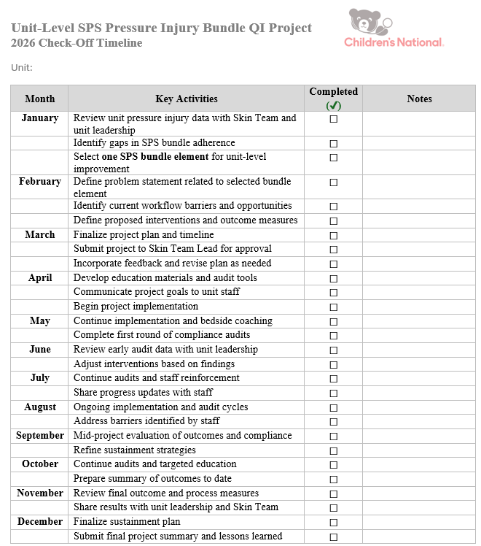
Project Checklist

Slide 24
Project Team and Roles
Skin Team Nurses: Lead project planning, education, audits, and data review
Unit Leadership (Managers/Educators): Support prioritization, remove barriers, reinforce expectations
Bedside Nurses: Participate in education, testing changes, and providing feedback
Interdisciplinary Partners (RT, PT, WOC, Nsg. Quality): Provide expertise aligned with the selected bundle element

Slide 25
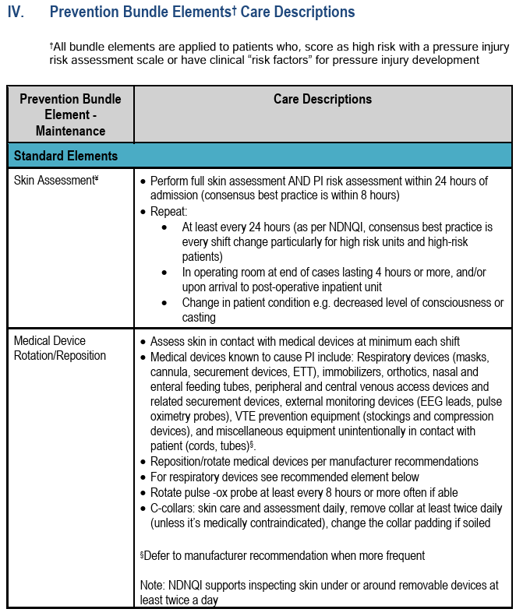
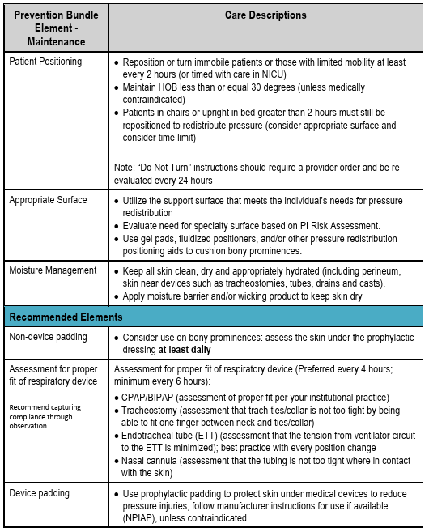
Additional SPS Information

Slide 26
Skin 101
Notes:
7 slides
Outline:
Normal skin layers
How skin heals
Wound Closure – primary, secondary, tertiary (delayed primary)
Moist wound healing
Because otherwise, as humans, we are just little bags of thinking water held up by fragile accumulations of calcium.
Definitions that I removed:
Wound
PI
Friction
Shear
Tear
Periwound
MARSI
Dermatitis
Incontinence Associated
Prolonged exposure to stool and/or urine
Intertriginous Dermatitis
Trapped, over hydration
Linear breaks at skin fold base

Slide 27
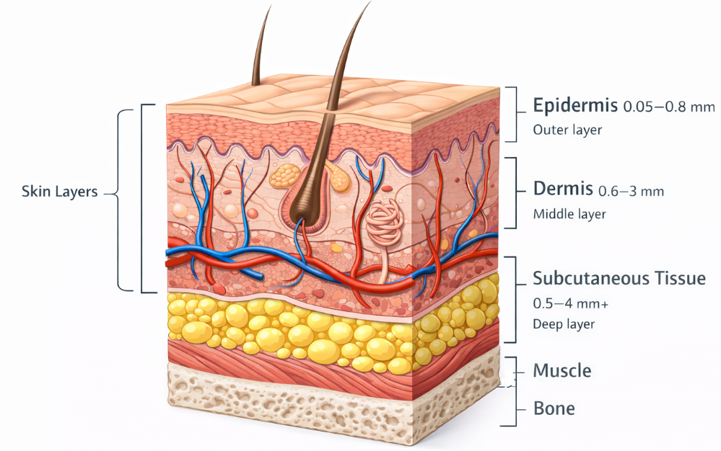
Normal Skin Layers
Skin is the largest organ system in the body, it serves the critical function of protecting the individual from the external environment and maintaining homeostasis of the internal environment.
Epidermis
  Avascular
  5 layers
Dermis
  Vascular
  2 layers
Subcutaneous
  loose connective tissue and fat
Muscle & Bone
Notes:
1. Epidermis
Description: The outermost layer of skin, made primarily of keratinized stratified squamous epithelium. It acts as a protective barrier.
Sub-layers (from outermost to innermost):
Stratum corneum – dead, keratinized cells
Stratum lucidum – only in thick skin (palms, soles)
Stratum granulosum
Stratum spinosum
Stratum basale – site of new cell production
Thickness:
Varies by body site:
Thin skin (e.g., eyelids): 0.05 mm
Thick skin (palms, soles): 0.6–0.8 mm
2. Dermis
Description: The middle layer, composed of connective tissue with collagen and elastin, housing blood vessels, nerves, hair follicles, sweat glands, and sebaceous glands.
Sub-layers:
Papillary dermis – superficial, loose connective tissue, forms dermal papillae
Reticular dermis – deeper, dense irregular connective tissue
Thickness:
Generally 0.6–3 mm, depending on location:
Eyelids: 0.6 mm
Back: up to 3 mm
3. Hypodermis (subcutaneous tissue)
Description: Not technically part of the skin, but lies beneath the dermis. Made of loose connective tissue and fat, it cushions the body, stores energy, and insulates.
Thickness:
Highly variable: 0.5–4 mm or more, depending on body site and individual fat composition.

Slide 28
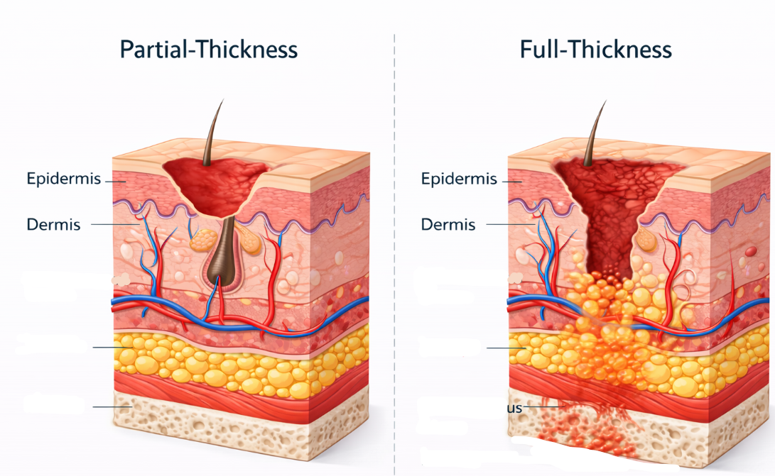
How Skin Heals
Partial-thickness
  Regeneration
    Epithelial resurfacing
    Contact inhibition
Full-thickness
  Scar Tissue Formation
  Phases
    Inflammatory
    Proliferative
    Maturation
Subcutaneous Tissue
Subcutaneous Tissue
Bone
Bone
Notes:
Regeneration
Epithelial resurfacing
Contact inhibition
Scar Tissue Formation
Four sequential, yet overlapping phases:
Hemostasis: the first phase of healing, the objective is to stop bleeding by activation of the clotting cascade.
Inflammatory: the focus of this phase is to prepare the wound bed for the growth of new tissue.
Proliferative: follows wound bed preparation and this phase’s main focus is to fill and cover the wound.
Remodeling: in the final phase, the new tissue is gaining strength and flexibility.

Slide 29
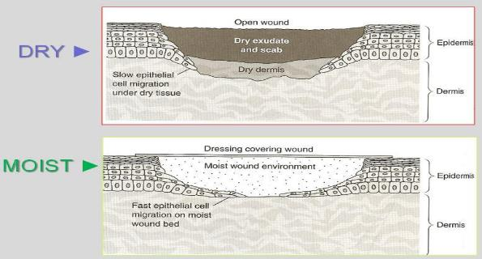
Moist Wound Healing
The principle of moist wound healing is that it mimics the function of the epidermis.
SLOW
2x FASTER

Slide 30
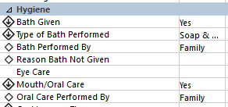
Promotion of Healthy Skin
Bathing
  DAILY
    Type of bath
      Wipes, bed bath, shower/tub, CHG
    Performed by
      Nursing staff, family, self
    Hair washing/mouth care
  If not given, specify why bath was not performed
  Surgical patients going to the OR should have a bath within 24 hours of their surgery

Slide 31
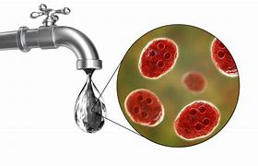
Infection Control Recommendations
Wipe basin with disinfectant wipe and let dry before use.
Let water run for 5 mins prior to filling up basin.
Linen change daily
Notes:
Waterborn diseases: caused by microorganisms, biotoxins,and toxic contaminants

Slide 32
Pressure Injuries (PIs)
Notes:
10 slides in this section

Slide 33
What IS a Pressure Injury (PI)?
Localized damage to the skin/underlying soft tissue
Result of
  Intense and/or prolonged pressure, or
  Pressure + shear
Location
  Over a bony prominence
  Related to a medical device

Slide 34
At-Risk for Pressure Injuries

Slide 35
Risk Assessment Scales
Braden QD
  At-risk = >13
NSRAS (NICU only)
  At-risk = <14
  Or….
At-risk based on clinical conditions
Notes:
Needs to be updated
If you have to talk yourself into if something counts or not, default to it counting

Slide 36
Braden QD
D for medical DEVICE(s)
Scoring
  > 13 = AT RISK
  < 12 = NOT at risk
Medical device scoring
  1 point for most medical device
    2 points for devices that can be moved/removed independently (e.g. SCDs, splints, braces, Prevalon boots)
  Maximum score = 8

Slide 37
Medical Device Examples (NOT all inclusive)
Vascular | Monitoring | Immobilizers | Securing Devices | Tubes/Drains | Respiratory
CVLs | EKG electrodes | Brace* | IV board | Foley catheter | Tracheostomy
Accessed port | EEG leads | Cast | Trach ties | Nephrostomy | ETT
Arterial line | Temp probe | Cervical Collar | Abdominal binder | PD catheter | Nasal trumpet
PIV | Pacing wire | Restraint*/ No-No* | NIPPV headgear | Chest tube | BiPAP/CPAP
Umbilical line | Pulse Oximeter | Splint* |  | Ostomy wafer/bag | Nasal cannula
CRRT catheter | NIRS | External fixator |  | External drain | Bite block
*Count each device separately

Slide 38
At-Risk Clinical Criteria
Immobile
  Can the patient make purposeful position changes to offload pressure?
Insensate
  Can the patient feel & respond to pain?
Sedated
  Is the patient on sedation medications?
Notes:
If you have to talk yourself into if something counts or not, default to it counting

Slide 39
Pressure Injury Bundle

Slide 40
Pressure Injury (PI) Bundle Elements
Skin Assessment
Devices
Turning
Moisture
Bed
  Best practice recommendations
    Aim: implementation of ALL bundle elements will reduce PIs development
  5 bundle elements
    Up to 32 separate documentation points
      In 24 hours

Slide 41
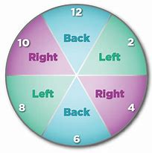
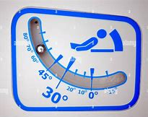
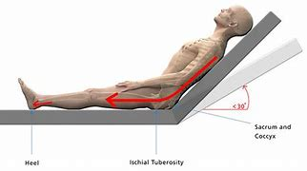
Pressure Injury Prevention Bundle Element –
Patient Positioning
Care Description of Elements
Turn ALL sedated, immobile, and/or insensate patients at least every 2 hours.
  In NICU, re-positioning is timed with cares.
  Medically Unstable requires LIP order q24
  Patient/family refusals
    “Patient moves self”
  Exclusions: infants <12mo who are not sedated (age appropriate) + all patients who can move themselves
Maintain HOB <30 degrees
(unless medically contraindicated).

Slide 42
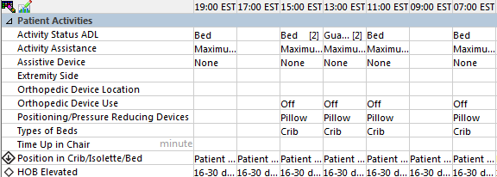
Pressure Injury Prevention Bundle Element –
Patient Positioning
iView →Activities of Daily Living → Patient Activities → Position in Crib/Isolette/Bed & HOB Elevation
Documentation Expectations

Slide 43
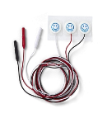
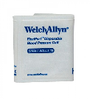
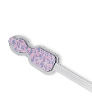
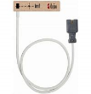
Pressure Injury Prevention Bundle Element –
Device Rotation
Care Description of Element
All medical devices in contact with the skin should be rotated.
  Rotate pulse ox probes, EKG leads, continuous BP cuffs, and NIRS according to the chart
    (Skin Care NPG)
When a device cannot be rotated, efforts to relieve pressure should be made.
  Cushion to protect
Rotatable Devices | At-Risk | Not At-Risk
EKG leads | every 24 hours | every 24 hours
NIRS | every 24 hours | every 24 hours
Pulse Ox | every 4 hours | every 8 hours
BP Cuff | every 4 hours | every 8 hours

Slide 44
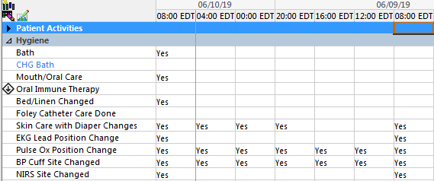
Pressure Injury Prevention Bundle Element –
Device Rotation
Documentation Expectations
iView →Activities of Daily Living → Patient Activities → EGK, Pulse Ox, BP Cuff, NIRS site rotation
*Also can audit by looking at sites in Vital Sign tab

Slide 45

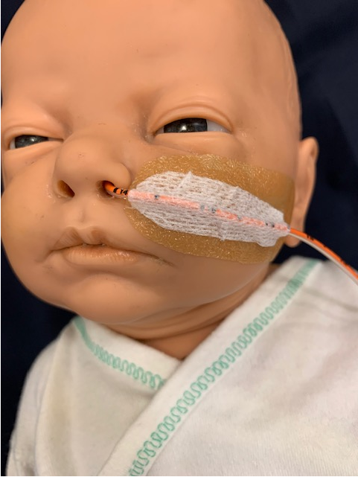
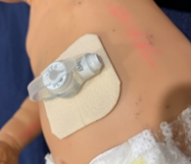
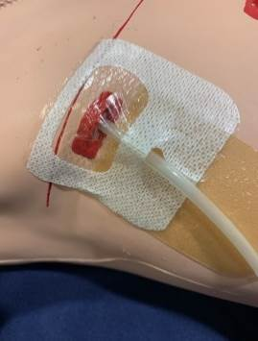
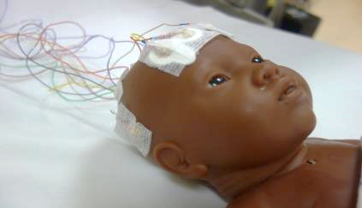
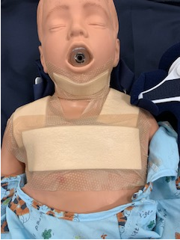
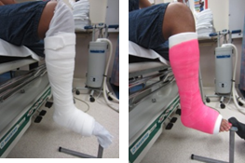
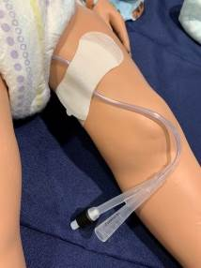
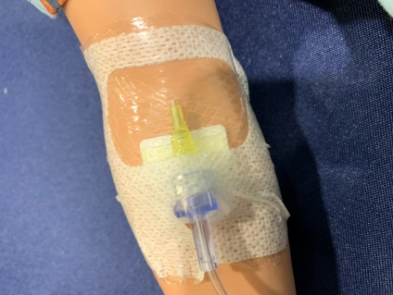
Skin Team/ Wound Team Updated 2021
CUSHION those Devices to PROTECT Skin Integrity
NG/OG/ND/NJ:
Skin Barrier Wipe (e.g. No Sting Skin Prep); Hydrocolloid (e.g. DuoDerm)
GT/GJ:
Foam dressing (e.g. Mepilex Lite); Grip-Lok
Chest Tube:
Hydrocolloid (e.g. DuoDerm), Skin Barrier wipe (e.g. No-Sting Skin-Prep)
EEG Leads:
Skin Savers
Cervical Collar:
Foam dressing (e.g. Mepilex Boarder), optional: Elastogel
Cast Edges:
Hydrocolloid (e.g. DuoDerm) or foam dressing (e.g. Mepilex, Mepilex Border, Mepilex Lite)
Foley:
Skin Barrier Wipe (e.g. No Sting Skin Prep); Hydrocolloid (e.g. DuoDerm), Grip-Lok
PIV:
Skin Barrier Wipe (e.g. No Sting Skin Prep), IV Start Kit

Slide 46
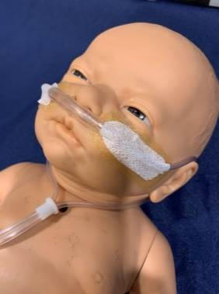
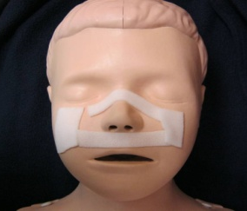
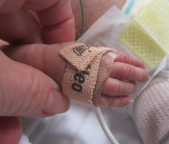
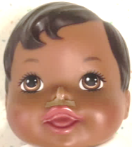
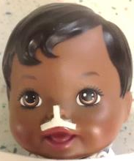
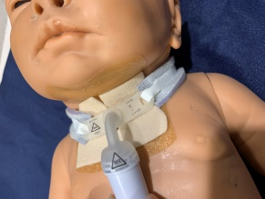
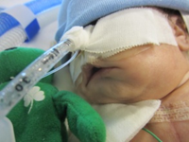
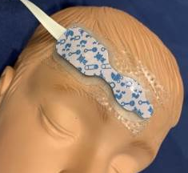
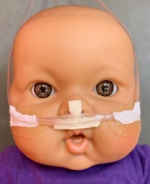
Skin Team/ Wound Team Updated 2021
CUSHION those Devices to PROTECT Skin Integrity
Nasal Cannulas, HFNC:
Skin Barrier Wipe (e.g. No-Sting Ski- Prep), Hydrocolloid (e.g. DuoDerm), cloth tape (e.g. Hypafix)
BiPAP, CPAP, SiPAP:
Skin Barrier Wipe (e.g. No-Sting Skin-Prep), Foam dressing (e.g. Mepilex Lite, Mepilex)
Pulse Ox:
Contact Layer (e.g. Mepitel One)
NICU Nasal Septum:
Hydrocolloid (e.g. DuoDerm), Foam dressing (e.g. Mepilex)
>2kg
<2kg
Nasal Cannula
Trach:
Skin Barrier Liquid (e.g. Cavilon AP); Foam dressing (e.g. Mepilex Lite or Mepilex) or Hydroconductive (e.g. Drawtex); optional: Hydrocolloid (e.g. DuoDerm); Mepilex Border Foam
ETT:
Skin Barrier Wipe (e.g. No-Sting Skin-Prep), Hydrocolloid (e.g. DuoDerm), cloth tape
NIRS:
Contact Layer (e.g. Mepitel One)

Slide 47
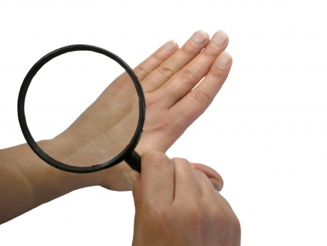
Pressure Injury Prevention Bundle Element –
Skin Assessment
Care Description of Element
Skin is assessed (head-to-toe)
  On admission
  Each shift
  Transfer of care

Slide 48
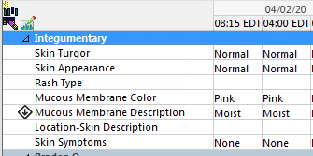
Pressure Injury Prevention Bundle Element –
Skin Assessment
iView →CC/AC ongoing assessment → Integumentary
Documentation Expectations

Slide 49
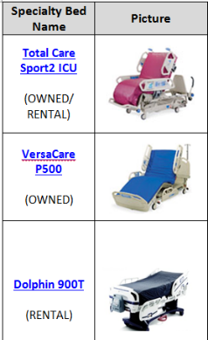
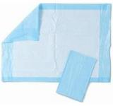

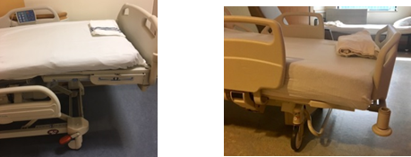

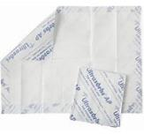
Pressure Injury Prevention Bundle Element –
Appropriate bed surface
Care Description of Element
Consider the use of a specialty bed
  Standard of care in PICU/CICU patients
  Reference in Skin Care NPG
“Microclimate” technology
  Minimize linen layers, only air permeable absorptive pads
Pad bony prominences
  Use of fluidized positioners, gel pads, wedges, etc.

Slide 50
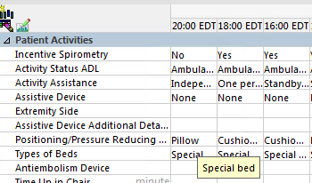
Pressure Injury Prevention Bundle Element –
Appropriate bed surface
Documentation Expectations
iView →Activities of Daily Living → Patient Activities → Types of Bed & Positioning/Pressure Reducing Devices

Slide 51

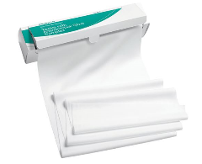

Pressure Injury Prevention Bundle Element –
Moisture Management
Care Description of Element
Barrier cream applied to all diapered/incontinent patients
Keep patients clean & dry
  Linen changes PRN, moisture wicking fabric in skin folds

Slide 52

Pressure Injury Prevention Bundle Element –
Moisture Management
Documentation Expectations
iView →Activities of Daily Living → Hygiene → Skin Care with Diaper Changes

Slide 53
Pressure Injury Staging

Slide 54
Base staging on what is visible
If you CAN see full extent of tissue injury
  Numeric stages (stages 1-4)
  Deep tissue pressure injury (DTPI)
  Mucosal membrane pressure injury (MMPI)
If you can NOT see full extent of tissue injury
  Unstageable/Unable to Stage (UTS)

Slide 55

Stage 1
What IS visible
  Intact skin
  Non-blanchable erythema
  Changes in sensation, temperature or firmness may precede visual changes
What is NOT visible
  Purple/maroon discoloration
Notes:
Plan to add in the drawing of stages on darkly pigmented skin

Slide 56



Stage 1

Slide 57

Stage 2
Partial-thickness skin loss
  Open skin (epithelial tissue visible)
  or
  Serous/serous filled blister
What is NOT visible
  Blood filled blister
  Adipose (fat) tissue
  Granulation tissue
  Necrotic tissue (slough/eschar)

Slide 58




Stage 2

Slide 59

Stage 3
What IS visible:
  Full-thickness skin loss
  Adipose (fat) tissue
  Granulation tissue
  Necrotic Tissue (slough/eschar)
What is NOT visible:
  Fascia or muscle
  Tendon or ligament
  Bone or cartilage

Slide 60



Stage 3’s

Slide 61

Stage 4’s
What IS visible (it only takes 1 )
  Full-thickness skin loss
  Fascia (exposed or palpable)
  Muscle
  Tendon
  Ligament
  Bone or cartilage
What is NOT visible
  Healthy skin

Slide 62


Stage 4

Slide 63


Deep Tissue Pressure Injury (DTPI)
What IS visible
  Intact or non-intact skin
  Deep red, maroon, or purple discoloration
    Non-blanchable
  May be a blood filled blister
Presents like a “bruise” but the etiology is caused from unrelieved PRESSURE and not from TRAUMA (e.g. bump, fall)
  Pressure from a body part on a mattress
  Pressure from a medical device
Light Skin
Dark Skin
Notes:
This is a “bottom-up” injury – ischemic injury at the bone/muscle interface

Slide 64




DTPI

Slide 65


Evolution of DTPIs
Deep Tissue Pressure Injuries (DTPIs) may worsen in appearance over the next several days and “open up” to reveal a shallow or deep wound underneath (with or without eschar)
Day 1
Initial injury found on patient’s scapula

Slide 66


Unstageable (UTS) Pressure Injury
What IS visible
  Necrotic tissue
    Full thickness injury
    When debrieded, will be staged as a Stage 3 or Stage 4
What is NOT visible
  The wound bed
    Identifiable tissue damage to determine extent of injury
Notes:
Extent of tissue damage within the ulcer CANNOT be confirmed because it is obscured by slough or eschar.
Obscured full-thickness skin & tissue loss.
If slough or eschar is removed, a Stage 3 or Stage 4 pressure injury will be revealed.
Occiput: they are visualizing non-viable/devitalized tissue
Yellow = slough
Brown/black = eschar (soft)
Hard eschar is leathery in appearance
Wound bed base needs to be exposed to determine the true depth
Ask them what stage it will not be?
S3 – no adipose tissue on occiputs
Knee: **working on a new image**

Slide 67


Necrotic Tissue
Necrotic tissue (avascular, devitalized/dead)
  Eschar: presents as dry, thick, leathery tissue Often tan, brown, or black
  Slough: presents as moist, firmly to loosely attached, and stringy. Often is yellow, tan, green, or brown

Slide 68



UTS

Slide 69

Mucosal Membrane (MM) PIs
On a mucous membranes
CANNOT be staged
  Different cellular anatomy
Requires history of/current medical device in that location

Slide 70


MMPI

Slide 71

Medical Device-Related PIs (MDRPIs)
Describes an ETIOLOGY
  NOT a stage
  Requires staging
Conforms to shape of medical device

Slide 72


New Data Collection Form

Slide 73

Data Sheet (Back Page- Notes)

Slide 74
National Benchmarking

Slide 75
Purpose of Data Collection
Determine the prevalence of HAPIs
Explore the relationship between nursing assessments, prevention interventions, & PI development

Slide 76
What Data Do We Collect?
Pressure Injuries
Everything Else
Hospital-acquired (HAPI)
Community-acquired (CAPI)
Medical device-related (MDRPI)
PI Bundle Compliance
  At-Risk Patients
Restraints
Falls
ID Bands
DOH Citations
  Wound Assessment Documentation

Slide 77

Unit Data Breakdown

Slide 78


Magnet Scorecard Overview: HAPI
Legend:
Units in green are above Performance Goal
Units in red are below Performance Goal
Data Time Frame: CY24 Q1 - CY 25 Q4 (FY23Q4 – FY25 Q3). All 8 quarters with benchmarked data

Slide 79
How-To Calculate: HAPI Prevalence
Required Data
Prevalence Rate Calculation
# assessed patients
# patients with HAPIs
  Included patients with MDRPIs
  Include MM PIs, but do not stage
# pts with a HAPI
100
# pts assessed
Notes:
Give example – use real month from CY19Q1

Slide 80
Calculation Practice: Prevalence
Data
Census: 270
  Assessed: 269
  Excluded: 1
Pressure Injuries > Stage 2
  5 HAPIs on 3 patients
    3 HAPIs on 2 patients were caused by medical devices
At-risk patients: 60
  Compliant bundles: 47
Calculation
1.12%
3
100
269

Slide 81
How-To Calculate: MDRPI Prevalence
Required Data
MDRPI Rate Calculation
# assessed patients
# patients with MDRPI
  Include patients with MMPIs
  Don’t include patients who HAPIs aren’t related to medical devices
# pts with a MDRPI
100
# pts assessed
Notes:
Give example – use real month from CY19Q1

Slide 82
Calculation Practice: MDRPI Prevalence
Data
MDRPI Prevalence
0.74%
Census: 270
  Assessed: 269
  Excluded: 1
Pressure Injuries > Stage 2
  5 HAPIs on 3 patients
    3 HAPIs on 2 patients were caused by medical devices
At-risk patients: 60
  Compliant bundles: 47
2
100
269
Notes:
Give example – use real month from CY19Q1

Slide 83
How-To Calculate: Bundle Compliance
Required Data
Calculation
# at-risk patients
# compliant bundles
# Compliant Bundles
100
# At-risk pts

Slide 84
Calculation Practice: Bundle Compliance
Data
78%
Census: 270
  Assessed: 269
  Excluded: 1
Pressure Injuries > Stage 2
  5 HAPIs on 3 patients
    3 HAPIs on 2 patients were caused by medical devices
At-risk patients: 60
  Compliant bundles: 47
Bundle Compliance
47
100
60

Slide 85
Yearly Aggregated Prevalence Data
68%
63%
64%
72%
76%
74%
58%

Slide 86
Skin Care NPG
Link to Skin Care NPG

Slide 87

Questions?

Slide 88

Key Takeaways
Share 1-2 things you learned in today’s course that will improve your care

Slide 89
How to Claim CE Credit
Skin Team Introduction Course
July 8, 2026
Submit the attendance code KOTMOD by:
  Texting to 301-273-7643, or
  Entering online at ce.childrensnational.org/code
Complete the Evaluation
Download CE Certificate
Credit may be claimed up to 60 days from the date of the live event.

Slide 90
Creating a CE Learner Account
(First-Time Users)
To claim continuing education (CE) credit, you must have a CE Learner Account.
Steps to Create Your Account:
Visit ce.childrensnational.org
Click “Sign In” in the upper right‑hand corner
Select one option:
  Single Sign‑On (Children’s National employees), or
  Create a Guest Account (non–Children’s National participants)
Complete all required profile fields (marked with a red asterisk)
Click “Create New Account” to finish
Important: Register Your Mobile Number (Required to link your attendance code)
From My Account, select the Edit tab
Click the Mobile tab
Enter your mobile phone number (numbers only—no dashes, parentheses, or spaces)
Click Save
Email any questions to ce@childrensnational.org

